Slide 1
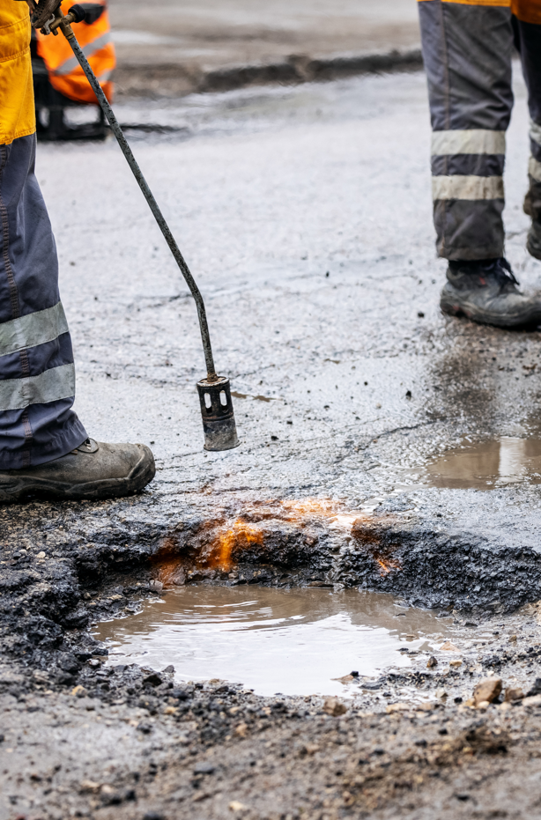
Potholes and pitfalls: How to fix local roads
November 2023

Slide 2
Potholes and pitfalls: How to fix local roads
There is not enough funding in the system
Councils are underspending on road maintenance by at least $1 billion annually
Delaying action will cost more in the long run
Untied funding is not going where it is needed most
Councils in less populous states are disadvantaged by the grants system
Too much funding is being diverted to self-sufficient councils
Tied funding imposes unnecessary burdens
Strict requirements on councils are wasting scarce council resources and are prohibitive for more remote communities
Inflexible rules are driving up costs for councils
Many councils need help to manage their roads
Councils lack the data, staff, and technology to properly maintain their roads

Slide 3
Commonwealth funding for local government has failed to keep up with costs
Financial Assistance Grants 2001-2022, actual value and estimated value if indexed by local government costs
FA Grants indexed to
local government costs
$3b
Actual FA Grants
$2b
Indexation freeze
Indexation freeze
2000
2005
2010
2015
2020
Notes: Values determined by taking value of grants in 2001 and indexing annually according to (a) the method outlined in the Local Government (Financial Assistance) Act 1995 (population and CPI growth), with an indexation freeze starting in 2014-15 and ending in 2016-17 (orange); (b) population and growth in the SA local government price index (red).
Sources: Department of Infrastructure, Transport, Regional Development, Communications and the Arts 2023a, The South Australian Centre for Economic Studies 2023, ABS 1999

Slide 4
Maintenance expenditure on roads has grown more slowly than road use
Growth in road use and maintenance expenditure, indexed relative to 2009
120
Road freight
(tonne-kilometres)
115
Passenger vehicles
110
(kilometres)
105
Maintenance
expenditure
100
2009
2014
2019
Notes: Expenditure has been adjusted by the BITRE Road Construction and maintenance Price (RCMP) and CPI
Sources: Council reported maintenance and renewal expenditure (NLRDS, IPWEA), BITRE 2022

Slide 5
Councils have expanded their services into other areas
Real growth in local government expenditure between 2013 and 2022, by category
Environmental protection
Recreation, culture, and religion
Education
Public order and safety
Health
Economic affairs
Housing and community amenities
General public services
Transport
Social protection
-10%
0%
10%
20%
30%
Source: ABS 2023a

Slide 6
Regional and remote Australians already face a high rates burden
Rates and charges revenue per resident, by council
Remote
Larger dots represent councils
with larger populations
$15,000
Regional
$10,000
$5,000
Major city
$0
$25,000
$50,000
$75,000
Average income per resident
Sources: ABS 2022b; ATO 2020a; ABS 2016; ABS 2020; ATO 2020b; ABS 2021a; ABS 2022a; and publicly available information from council budget documents.

Slide 7
The under-spend on road maintenance is much greater in regional and remote areas
Median additional spending needed to maintain roads in current condition
60%
40%
20%
0%
Major cities
Regional
Remote
Sources: Grattan Institute modelling (see Appendix A on page 65)

Slide 8
The required increase in funding is only a small share of annual road expenditure
Annual road expenditure by level of government, and local road funding gap, 2021
$15b
$10b
$5b
$0b
Federal
State
Local road funding gap
Sources: BITRE 2022b, Grattan modelling (see Appendix A)

Slide 9
Our recommendations
The federal government should:
Boost the Financial Assistance Grants by $600 million,
Increase Roads to Recovery by $400 million and make the program ongoing,
Index both funds to an accurate cost index and population.
Establish a $200 million per year fund to assess and upgrade
local roads identified as priority freight routes, in exchange for the
council providing permit access to compliant heavy vehicles

Slide 10
Potholes and pitfalls: How to fix local roads
There is not enough funding in the system
Councils are underspending on road maintenance by at least $1 billion annually
Delaying action will cost more in the long run
Untied funding is not going where it is needed most
Councils in less populous states are disadvantaged by the grants system
Too much funding is being diverted to self-sufficient councils
Tied funding imposes unnecessary burdens
Strict requirements on councils are wasting scarce council resources and are prohibitive for more remote communities
Inflexible rules are driving up costs for councils
Many councils need help to manage their roads
Councils lack the data, staff, and technology to properly maintain their roads

Slide 11
Regional and remote councils manage vast road networks with limited scope to raise revenue
Share of funding, population and road length by council remoteness
100%
75%
Major cities
50%
25%
Regional
0%
Remote
Land area
Road length
Population
Rates income
Sources: ALGA 2021; ABS 2022a, Grattan analysis of publicly available council budgets and financial statements

Slide 12
Councils in less populous states are disadvantaged by the distribution of grants
Financial Assistance Grants received per capita by remote councils, by state, 2021
$1,500
$1,000
$500
$0
NT
SA
Tas
WA
Qld
NSW
Notes: Grants received in the 2020-21 financial year. There are no councils in Victoria with most of their population in a remote area.
Source: Department of Infrastructure, Transport, Regional Development and the Arts 2023.

Slide 13
Simplifying the Financial Assistance Grants would help close the remote and regional funding gap
Median council revenue as share of expenditure need, by remoteness, WA
150%
125%
100%
Adjusted
75%
Current
50%
Major cities
Regional
Remote
Note: Adjusted distribution is determined by lowering the minimum grant to 10% and allocating the local roads component and Roads to Recovery funding on the same basis as the general grant (Figure 3.5 on the preceding page).
Source: Values for revenue and expenditure need taken from WA Local Government Grants Commission calculations (2021 financial year).

Slide 14
Our recommendations
The federal government should:
  Task the Commonwealth Grants Commission with determining a new basis for the distribution of Financial Assistance Grants to the states
  Reduce the minimum grant from 30 to 10 per cent of councils’ per capita share of funding
  Combine the separate grant components and distribute the entire pool on an equalisation basis

Slide 15
Potholes and pitfalls: How to fix local roads
There is not enough funding in the system
Councils are underspending on road maintenance by at least $1 billion annually
Delaying action will cost more in the long run
Untied funding is not going where it is needed most
Councils in less populous states are disadvantaged by the grants system
Too much funding is being diverted to self-sufficient councils
Tied funding imposes unnecessary burdens
Strict requirements on councils are wasting scarce council resources and are prohibitive for more remote communities
Inflexible rules are driving up costs for councils
Many councils need help to manage their roads
Councils lack the data, staff, and technology to properly maintain their roads

Slide 16
Tied funding imposes unnecessary burdens
Strict timing requirements are driving up council costs
Excessive application and reporting requirements are draining council resources
A bias towards new projects, not maintenance, is making the spending gap worse

Slide 17
Our recommendations
Federal and state governments should:
  Provide councils a minimum of two years to acquit grants
  Ensure maintenance and renewal spending is eligible for tied grant funding where consistent with objective criteria
  Account for the ongoing costs of maintaining new investment when allocating tied grants
  minimise duplication in grants administration by standardising and sharing application and reporting data between departments
  By default, provide funding on an allocative rather than competitive basis
  Minimise any co-contribution requirements, and where a business case is required, include this in the grant funding

Slide 18
Potholes and pitfalls: How to fix local roads
There is not enough funding in the system
Councils are underspending on road maintenance by at least $1 billion annually
Delaying action will cost more in the long run
Untied funding is not going where it is needed most
Councils in less populous states are disadvantaged by the grants system
Too much funding is being diverted to self-sufficient councils
Tied funding imposes unnecessary burdens
Strict requirements on councils are wasting scarce council resources and are prohibitive for more remote communities
Inflexible rules are driving up costs for councils
Many councils need help to manage their roads
Councils lack the data, staff, and technology to properly maintain their roads

Slide 19
Many councils lack basic information about their road and bridge assets
Share of councils with accurate information about their assets, by remoteness
Number of bridges
Number and length of roads
Condition of roads
Age of bridges
Age of roads
Major
City
Regional
Load capacity of bridges
Remote
Traffic on roads
0%
25%
50%
75%
100%
Source: Grattan Road Manager Survey, 2023. See Appendix D for further detail.

Slide 20
Many councils are not adequately planning
Share of surveyed councils with plans, by remoteness
Asset Management Plan
In date
Out of date
Never had one
Remote
Regional
Major City
Long-Term Financial Plan
Remote
Regional
Major City
Integrated Asset and Financial Plans
Integrated
Not integrated
Missing component
Remote
Regional
Major City
0%
25%
50%
75%
100%
Source: Grattan Road Manager Survey, 2023. See Appendix D for further detail.

Slide 21
Councils face serious headwinds to doing better
Staffing
Data
Technology

Slide 22
Remote and regional councils have less staff dedicated to asset management
Full-time equivalent asset management staff by remoteness, share of councils
100%
Multiple FTE
75%
1 FTE
50%
<1 FTE
25%
None
0%
Major City
Regional
Remote
Source: Grattan Road Manager Survey, 2023. See Appendix D for further detail

Slide 23
Different councils report vastly different expected life-spans for similar roads
Number of councils
15
10
5
0
0-10
10-20
20-30
30-40
40-50
50-60
60-70
70-80
80-90
90-100
> 100
Useful life of a local sealed road (years)
Source: IPWEA NSW 2020.

Slide 24
A roadmap for improvement
The federal government should:
  Establish a national road hierarchy and minimum service level standards for local roads
  Establish a short list of essential data items and consistent methods of collecting and reporting them
  Support under-resourced councils by collecting the data directly, providing necessary training and technology, or a mixture of both
State governments should:
  Provide up-to-date templates for asset management plans and long-term financial plans to councils, free of charge
  Offer training to councils with poor quality plans to improve their practices

Slide 25
Potholes and pitfalls: How to fix local roads
There is not enough funding in the system
Councils are underspending on road maintenance by at least $1 billion annually
Delaying action will cost more in the long run
Untied funding is not going where it is needed most
Councils in less populous states are disadvantaged by the grants system
Too much funding is being diverted to self-sufficient councils
Tied funding imposes unnecessary burdens
Strict requirements on councils are wasting scarce council resources and are prohibitive for more remote communities
Inflexible rules are driving up costs for councils
Many councils need help to manage their roads
Councils lack the data, staff, and technology to properly maintain their roads

