Slide 1

A better bet: How Australia should prevent gambling harm
Briefing pack
September 2024

Slide 2
Australia leads the world in gambling losses
Gambling losses per adult in 2022, AUD
Source: H2 Gambling Capital.

Slide 3
Australians lose $24 billion a year, mostly on pokies and betting
Total losses by gambling type, 2020-21
$25b
$20b
$15b
$6b
$24b
$10b
$12b
$5b
$0b
Pokies
Betting
Lotteries
Casino
Keno
Total
Notes: $45 million spent on minor gaming and $11 million spent on interactive gaming are not shown.
Source: Queensland Government Statistician's Office (2023).

Slide 4
Pokies are everywhere, particularly in NSW
Number of pokies, as at 30 June 2021
100,000
Australia accounts for about 0.3% of the world’s population, but 18% of the world’s poker machines
Casino
Hotel
75,000
Club
50,000
25,000
0
Pokies per 1000 adults:
NSW
Qld
Vic
SA
ACT
Tas
NT
WA
14 | 11 | 6 | 9 | 10 | 8 | 12 | 0.7
Source: Queensland Government Statistician's Office (2023).

Slide 5
In some communities, particularly poorer communities, it’s difficult to find venues without pokies
Proportion of pubs and clubs in local government area that have pokies
NSW
Queensland
Victoria
100%
75%
50%
25%
0%
900
1000
1100
900
1000
1100
900
1000
1100
Index of socio-economic advantage
Notes: Each point represents one local government area. The bigger the point, the bigger the population of the local government area.
Source: ABS (2022), ABS (2023), Liquor Control Victoria (2024), Queensland Office of Liquor and Gaming Regulation (2024) and NSW Liquor & Gaming (2024).
Notes:
Trend lines are weighted by population. NSW data are from July 2024, and include venues that have a club, hotel, or small bar licence. Queensland data are from August 2024, and include venues that are classified as a club, hotel, bar, or nightclub. Victorian data are from June 2024 and include venues that have a club, on-premises, or general licence.

Slide 6
Young men have led the rise in betting
Proportion of age group that places a bet in a regular month
Men
Women
20%
2022
15%
10%
2015
5%
0%
18-24
25-34
35-44
45-54
55-64
65-74
75+
18-24
25-34
35-44
45-54
55-64
65-74
75+
Source: Melbourne Institute for Applied Economic and Social Research (2023).

Slide 7
Gambling spending is highly concentrated: a few bear the brunt of losses
Debit card gambling spending, among customers with at least one gambling transaction
Proportion of
gambling
spending
Top
11-20%
Top
5%
Remaining 80%
Proportion of
customers
Top
6-10%
0%
25%
50%
75%
100%
Notes: This figure is based on consumer debit card transactions data from a bank, covering the year to 19 May 2024. Transactions are classified according to merchant category code. Gambling transactions include lottery, casino, racing, and betting transactions. Spending on pokies is not captured in the debit card data.

Slide 8
But gambling harm ripples through our communities
Gambling causes financial and mental distress
  In 2022, about 338,000 people suffered acute gambling harm
Family members, friends, and colleagues can also suffer as a result of someone else’s gambling
  About 700,000 people live with someone experiencing serious gambling harm
  Gambling is linked to domestic and family violence
The broader community also bears the costs of crime, health care, job losses, and other issues related to gambling
More gambling is associated with worse mental and financial health
Change in probability of outcome for people living within 250m of venue with pokies, relative to people living more than 2km from venue with pokies
Notes: Controls for neighbourhood fixed effects, area-level covariates and individual covariates.
Source: Badji, Black & Johnston (2023)

Slide 9
Our roadmap to prevent gambling harm
Time
Reduce exposure
Ban gambling ads and inducements
Rein in pokies numbers over time
Warnings on games
Mandatory pre-commitment with max limits
for pokies & online betting
Online gambling pre-commitment system
State-wide pokies pre-commitment schemes
Investigate the feasibility of a single universal system
Improve gambling support services
Build the evidence base
Invest in the gaps

Slide 10
Ban all gambling advertising: a partial ban won’t do enough to reduce exposure
Number of gambling ads on TV between April and June, by time of broadcast
From March 2018: restrictions on gambling ads during sport broadcasts between 5am and 8.30pm
2018-19
(after restrictions)
2016-17
(before restrictions)
Notes: Combined number of ads across metro and regional TV markets. The restrictions between 5am and 8.30pm ban gambling advertising during play and five minutes either side of the coverage of the live sporting event.
Source: Australian Communications and Media Authority (2019).

Slide 11
We also need a ‘seatbelt’ on the most dangerous gambling products
A national pre-commitment system for online gambling and state-based schemes for pokies, with the following features:
Everyone chooses their limits before they gamble
Regulated upper limits on losses: e.g. $100 a day, $500 a month, and $5000 a year (as per Tasmania’s pokies scheme under development)
Must be mandatory (voluntary schemes don’t work)
Gamblers can lower their limits anytime
Gamblers can raise their limits with a delay (up to the regulated upper limit, or subject to an affordability check)
Option to self-exclude completely

Slide 12
Different states have different starting points when it comes to rolling out pokies pre-commitment
Note: Numbers are gaming machines in operation as at 30 June 2021.
Sources: Queensland Government Statistician’s Office (2023) and expert consultation.

Slide 13
Sport, and free-to-air TV, will survive without gambling ads
Broadcasters’ revenue didn’t decline after tobacco ads were banned
Advertising spots and sport sponsorships are expensive because they are valuable
Gambling advertising is visible, but not irreplaceable: other advertisers would emerge
Sport and TV companies adapted to the tobacco ad ban
Commercial broadcasting revenue, 2024 dollars
Tobacco ads
phased out
$3b
TV
$2b
$1b
Radio
$0b
1968
1970
1972
1974
1976
1978
1980
1982

Slide 14
Clubs can still serve their communities with less pokies revenue
Club turnover, but not sport or social connection, increases with pokies prevalence
Clubs can still offer social connection and entertainment with less pokies revenue (WA clubs are prolific, despite being pokies-free)
Sports coaches, volunteering, and social connection don’t increase with pokies numbers – only club turnover
Job transitions can be managed smoothly: very few people are employed in gambling-specific jobs; hospitality is a high-turnover industry with highly transferable skills
Club community grants are small and mostly to themselves
Note: Each point represents one state. Sources: Queensland Government Statistician’s Office (2023); ABS (2019, 2022, 2023)

Slide 15
Most people will be unaffected by our proposed reforms
The vast majority of gamblers spend less than $500 a month
Pre-commitment for pokies would be a small, one-off hassle – like signing up for a library card
For online gamblers, who must already prove their identity to create an account, it should add little to the sign-up process
Most gamblers’ spending will be unaffected by our proposed maximum loss limit of $500 a month
Number of people by reported monthly gambling spending, 2022
Betting
800,000
600,000
400,000
200,000
0
Pokies
800,000
600,000
400,000
200,000
0
$1,000
$2,000
$3,000
$0
$500
Notes: Only people with non-zero spending are shown. Source: Melbourne Institute for Applied Economic and Social Research (2023).

Slide 16
The risk from legal gambling is bigger than the risk from illegal gambling
Mass exodus to offshore providers very unlikely
Pre-commitment adds only small frictions
Most people’s spending unaffected by maximum limits
Legal websites still available
For heavy gamblers, legal websites not much safer
Some people in the grip of addiction may seek out unlicensed websites in a deliberate attempt to circumvent limits
But legal websites not much safer in this situation – current consumer protection safeguards are weak
Better ways to target illegal gambling without compromising protection
Governments should focus on making legal platforms safer, blocking illegal platforms (including more tools for ACMA if needed), and ensuring that people suffering harm can access good support services

Slide 17
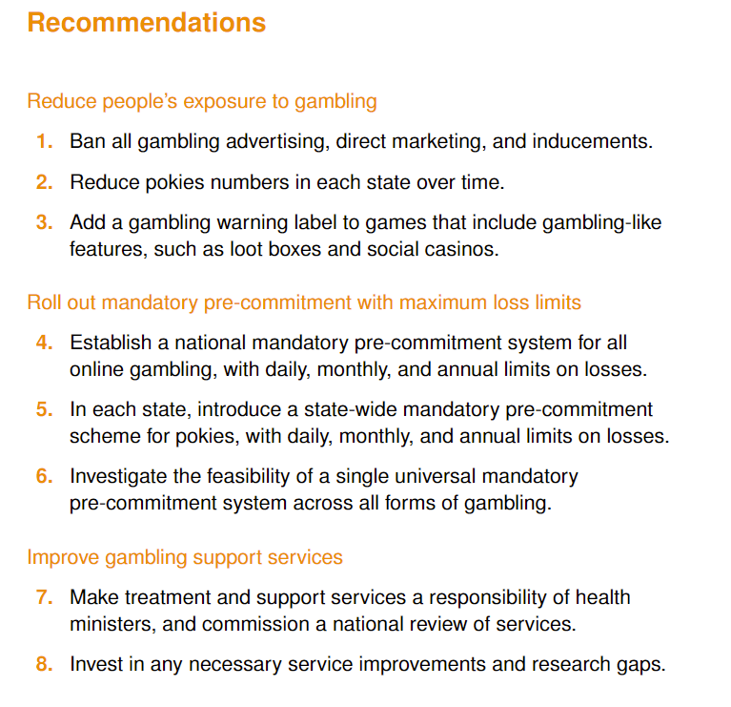
Australia has an opportunity for multi-jurisdiction, multi-partisan reform to prevent gambling harm
Strength in numbers:
Every jurisdiction has work to do
Coordinating reform across
jurisdictions makes the changes simpler for Australians to navigate and strengthens governments to withstand vested interest pushback
A National Taskforce should implement this roadmap to prevent gambling harm

